Slide 1
Arista Programmability
eAPI | EosSdk | Python | PowerShell | C++

Slide 2
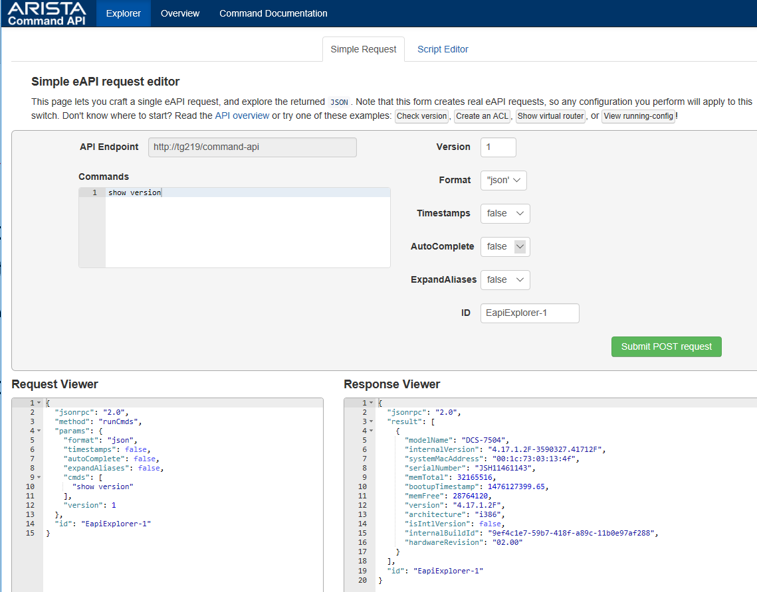
eAPI: Basic Operation
Step 1: Enable eAPI + Bonus (in)security settings
Step 2: Verify on-switch @ http://<switch-addr>/explorer.html
aaa authorization exec default local
aaa authentication policy local allow-nopassword-remote-login
!
username admin privilege 15 role network-admin
!
management api http-commands
protocol http
no shutdown

Slide 3
eAPI: Switch Based Script Editor
Edit JavaScript inline
Fully functional
Provide more advanced playground for testing with eAPI
Good reference if you know JavaScript
  Further reading: http://<switch-addr>/main.js

Slide 4
Basic Python

Slide 5
Handling eAPI Responses

Slide 6
Escaping from the CLI

Slide 7
Handling Errors from eAPI

Slide 8
PowerShell

Slide 9
EOSSDK
What for? An on-box agent to handle events (a reactor)
  Examples
    Stream counters (see TerminAttr)
    Make run-time changes to routing tables, ACLs, etc.
    Reacting to congestion or denial of services attacks…
    Now I’m rambling… Just look here: https://github.com/aristanetworks/EosSdk/wiki

Slide 10
EOSSDK: Hello World
Let’s stick to python for now…

Slide 11
EOSSDK: A More Useful Example?

